Slide 1
Black Hole Astrophysics Chapters 6.5.2 6.6.2.3 9.1~9.2.1
Including part of Schutz Ch4
All figures extracted from online sources of from the textbook.

Slide 2
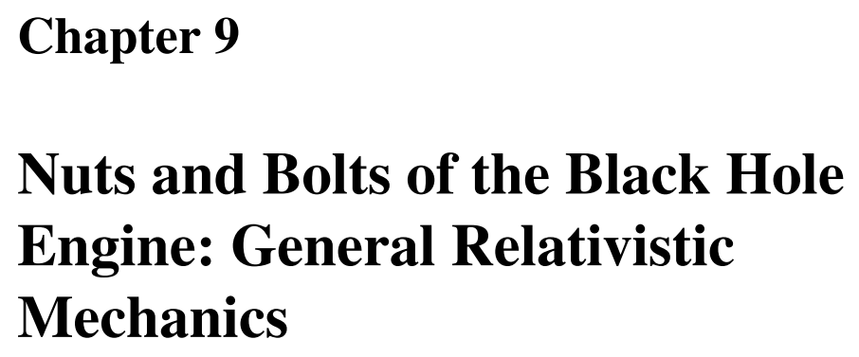

Slide 3
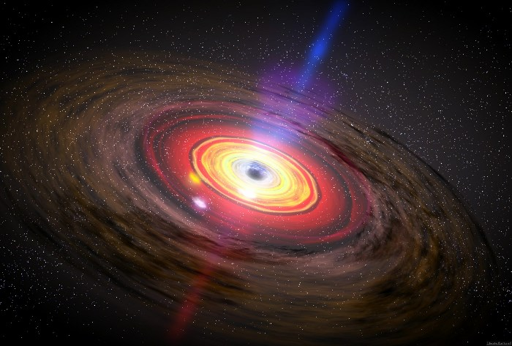
Overview
One of the most attractive, and also most daunting, features of astrophysics is that it brings together physics from many different ﬁelds and deals in the extremes of speed, gravity, temperature, and density.
The deep gravitational potential of the black hole provides a stable engine block on which are hung all the key systems of the black hole engine. Many Schwarzschild radii away from the black hole lies the carburetion system.
Fuel, in the form of gas clouds, or even whole stars, is tidally torn apart and dispersed into a smooth vapor of plasma ﬂowing into the central regions of the engine. Within ten Schwarzschild radii lies the accretion disk combustion chamber, where the fuel releases its gravitational (not chemical or nuclear) energy, creating a power output greater than that of any other engine in the universe.

Slide 4
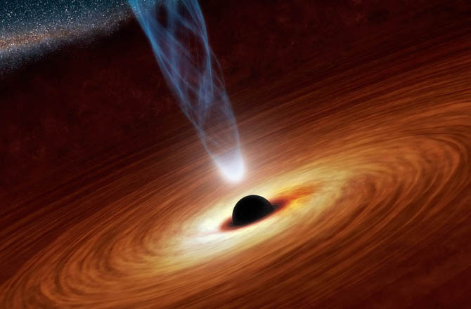
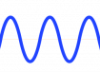
The five exhaust systems
Winds and jets of nonthermal particles driven by a magnetic turbine up to ~0.99c
Thermal wind up to ~0.1c
Emitted light
Advection of plasma and heat into BH
Viscous Transport of angular momentum outward in disk

Slide 5
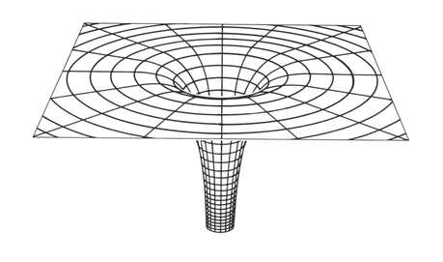
Goal of this chapter
Previously, we have discussed how electromagnetism works in spacetime and how gravity turns out to being a manifestation of curved spacetime.
As far as we know, the conservation laws of physics operating within the gravitational field of the black hole and in the electromagnetic field of the plasma, are responsible for the inner workings of the engine components.
This chapter on BH physics, therefore, will concentrate on the details of the conservation laws.

Slide 6
Overview of General Relativstic Mechanics
Quantum Mechanics
Boltzmann Equation
Particle
Approximation
Moment
Integrals
Particle Mechanics
Multi-Fluid Equation
Liouville Theorem
Statistical
Approximation
Sum Over
Particle Species
Statistical Mechanics
One-Fluid Equation
Equation of State

Slide 7
Overview of General Relativstic Mechanics
Quantum Mechanics
Boltzmann Equation
Particle
Approximation
Moment
Integrals
Particle Mechanics
Multi-Fluid Equation
Louville Theorem
Statistical
Approximation
Sum Over
Particle Species
Statistical Mechanics
One-Fluid Equation
Equation of State

Slide 8
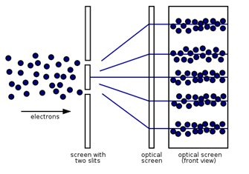
Quantum Mechanics & Particle Approximation
Quantum Mechanics is the most complete description of our world, it is most commonly used when the wave properties of particles become important.
However, in this book, QM is neglected mainly due to two reasons:
1. A full General Relativistic Quantum Mechanical Theory hasn’t been found
2. The quantum mechanical aspects (e.g. Hawking Radiation) of BHs are not observable by astronomers yet.
Therefore, the first approximation we can use is to assume that matter can be described by classical particles rather than waves.

Slide 9
Overview of General Relativstic Mechanics
Quantum Mechanics
Boltzmann Equation
Particle
Approximation
Moment
Integrals
Stellar Dynamics
Particle Mechanics
Multi-Fluid Equation
Louville Theorem
Charged Particles
Sum Over
Particle Species
Statistical
Approximation
Statistical Mechanics
One-Fluid Equation
Equation of State

Slide 10
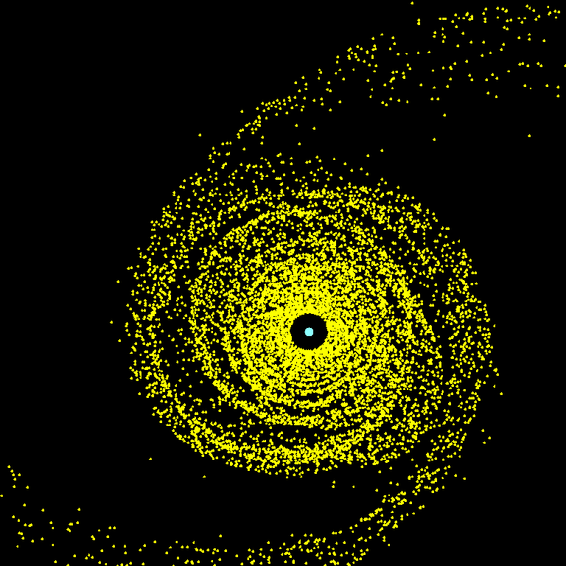
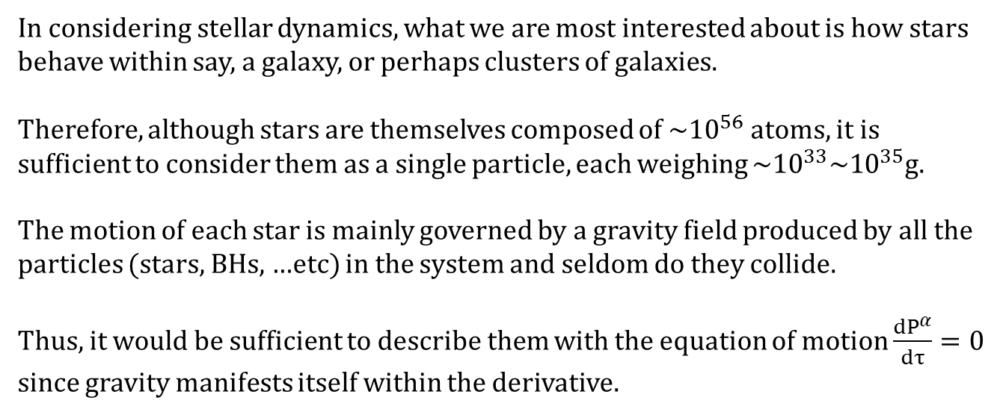
Stellar Dynamics
In considering stellar dynamics, what we are most interested about is how stars behave within say, a galaxy, or perhaps clusters of galaxies.
Therefore, although stars are themselves composed of ~${10}^{56}$ atoms, it is sufficient to consider them as a single particle, each weighing ~${10}^{33}\sim {10}^{35}$g.
The motion of each star is mainly governed by a gravity field produced by all the particles (stars, BHs, …etc) in the system and seldom do they collide.
Thus, it would be sufficient to describe them with the equation of motion $\frac{{dP}^{α}}{dτ}=0$ since gravity manifests itself within the derivative.
N-body simulations, which compute the motions of many stars, are employed extensively in the study of BH formation and fueling.
Discussion in Ch10,11.

Slide 11
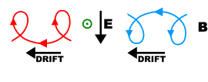
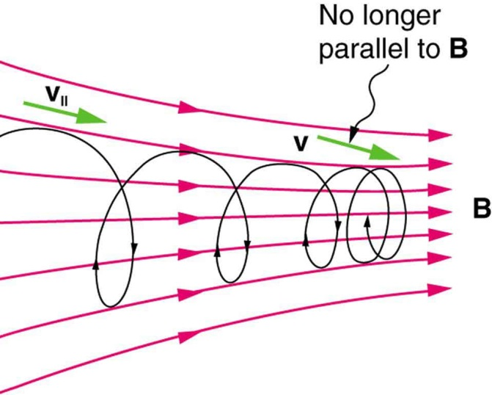
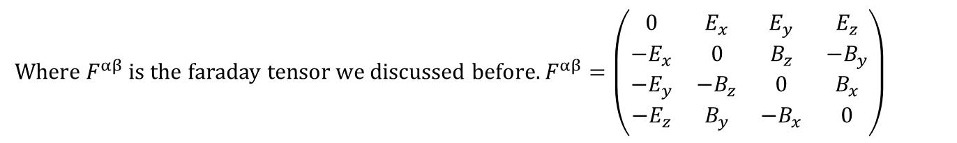
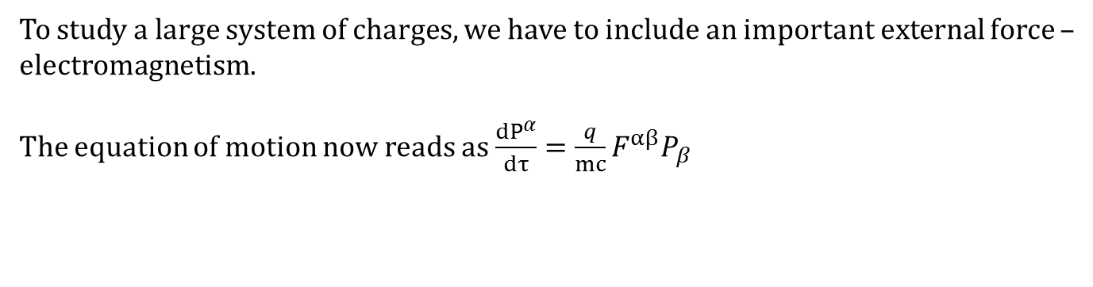
Charged Particle Dynamics
To study a large system of charges, we have to include an important external force – electromagnetism.
The equation of motion now reads as $\frac{{dP}^{α}}{dτ}=\frac{q}{mc}⁢F^{αβ}⁢P_{β}$
Where $F^{αβ}$ is the faraday tensor we discussed before. $F^{αβ}=\left(\begin{matrix}0 & E_{x} & E_{y} & E_{z} \\ −E_{x} & 0 & B_{z} & −B_{y} \\ −E_{y} & −B_{z} & 0 & B_{x} \\ −E_{z} & B_{y} & −B_{x} & 0\end{matrix}\right)$
Charged particle N-body simulations are sometimes used to study microscopic processes in relativistic jets and in very low-density accretion ﬂows and winds near black holes. However, in this book we treat charged particles not as individual entities but as members of a large system of particles called a plasma.

Slide 12
Overview of General Relativstic Mechanics
Quantum Mechanics
Boltzmann Equation
Particle
Approximation
Moment
Integrals
Stellar Dynamics
Particle Mechanics
Multi-Fluid Equation
Louville Theorem
Charged Particles
Sum Over
Particle Species
Statistical
Approximation
Statistical Mechanics
One-Fluid Equation
Equation of State

Slide 13
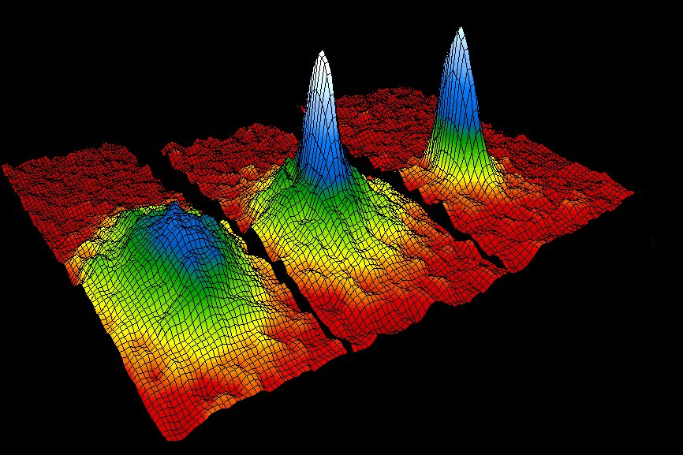
Statistical Mechanics
As was mentioned in Plasma Astrophysics class,
Rather than trying to follow each particle, we can use a statistical approach and deal with particles in a probabilistic manner.
This allows us to determine be able to useful thermodynamic quantities of a plasma, such as internal energy, pressure, entropy, heat capacities, chemical potential, etc.
Like particle mechanics, statistical mechanics has had important applications in stellar dynamics. Before computers were powerful enough to perform large N-body simulations, the Fokker–Planck equation (which evolves the probability density
function for star particles) was employed to study the evolution of globular clusters and galactic star systems. This is brieﬂy discussed in Chapter 10.
However, a still simpler statistical approach is taken in the case of studying the behavior of plasmas.

Slide 14
Overview of General Relativstic Mechanics
Quantum Mechanics
Boltzmann Equation
Particle
Approximation
Moment
Integrals
Stellar Dynamics
Particle Mechanics
Multi-Fluid Equation
Louville Theorem
Charged Particles
Sum Over
Particle Species
Statistical
Approximation
Statistical Mechanics
One-Fluid Equation
Equation of State

Slide 15
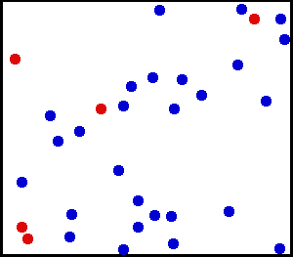
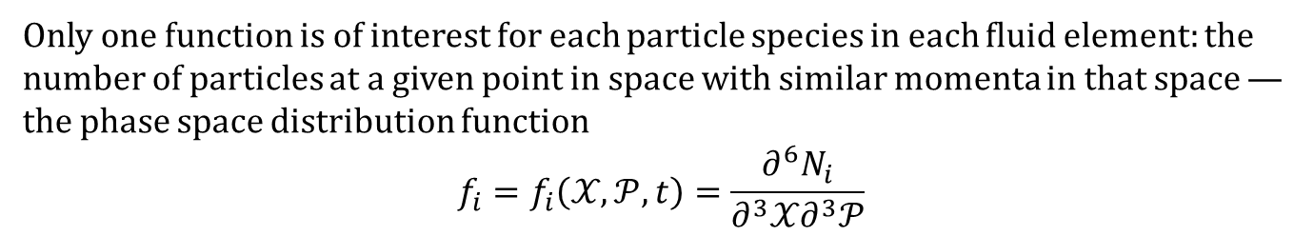
Kinetic Theory
Kinetic theory considers a ﬂuid or gas to be composed of many systems of particles, each occupying a small volume compared to the total size of the ﬂuid being simulated but nevertheless still comprising a large number of particles. Each of these small systems is called a ﬂuid element.
Only one function is of interest for each particle species in each ﬂuid element: the number of particles at a given point in space with similar momenta in that space — the phase space distribution function
$$f_{i}=f_{i}⁢\left(𝒳,𝒫,t\right)=\frac{∂^{6}N_{i}}{∂^{3}𝒳⁢∂^{3}𝒫}$$

Slide 16
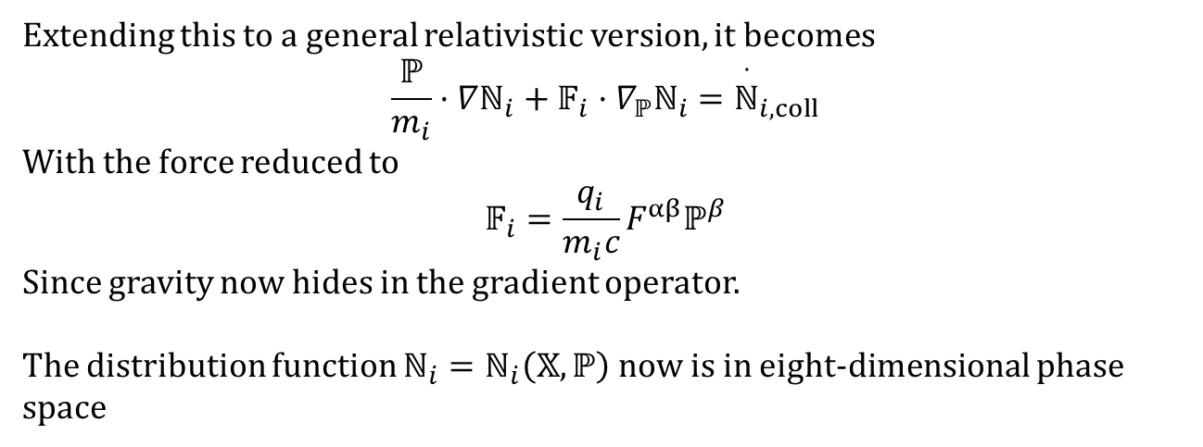
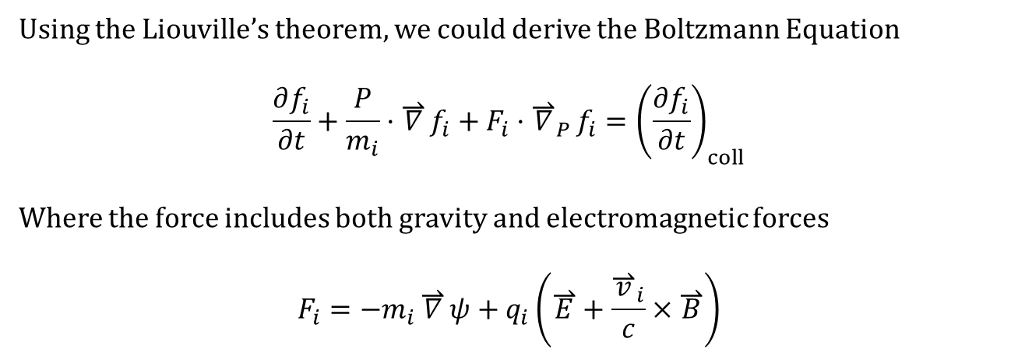
The Boltzmann Equation
Using the Liouville’s theorem, we could derive the Boltzmann Equation
$$\frac{∂f_{i}}{∂t}+\frac{P}{m_{i}}·\overset{⇀}{∇}f_{i}+F_{i}·{\overset{⇀}{∇}}_{P}f_{i}={\left(\frac{∂f_{i}}{∂t}\right)}_{coll}$$
Where the force includes both gravity and electromagnetic forces
$$F_{i}=−m_{i}⁢\overset{⇀}{∇}ψ+q_{i}⁢\left(\overset{⇀}{E}+\frac{{\overset{⇀}{v}}_{i}}{c}×\overset{⇀}{B}\right)$$
Extending this to a general relativistic version, it becomes
$$\frac{ℙ}{m_{i}}·∇ℕ_{i}+𝔽_{i}·∇_{ℙ}ℕ_{i}={\overset{·}{ℕ}}_{i,coll}$$
With the force reduced to
$$𝔽_{i}=\frac{q_{i}}{m_{i}⁢c}⁢F^{αβ}⁢ℙ^{β}$$
Since gravity now hides in the gradient operator.
The distribution function $ℕ_{i}=ℕ_{i}⁢\left(𝕏,ℙ\right)$ now is in eight-dimensional phase space

Slide 17
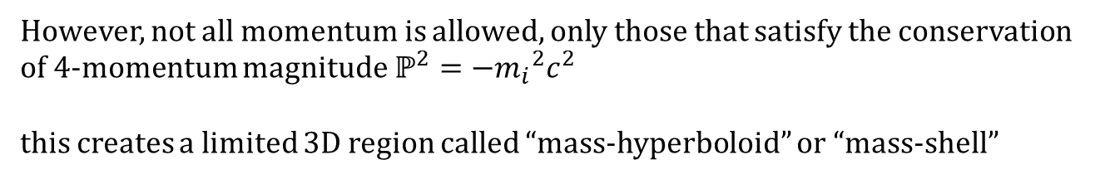
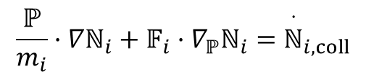
Constraints
$$\frac{ℙ}{m_{i}}·∇ℕ_{i}+𝔽_{i}·∇_{ℙ}ℕ_{i}={\overset{·}{ℕ}}_{i,coll}$$
However, not all momentum is allowed, only those that satisfy the conservation of 4-momentum magnitude $ℙ^{2}=−{m_{i}}^{2}⁢c^{2}$
this creates a limited 3D region called “mass-hyperboloid” or “mass-shell”
The great advantage of kinetic theory is the ability to evolve the distribution of particle momenta at every point in space. However, current computers can barely cope with the evolution of the three-dimensional simulations; accurate evolution in 6-dimensional phase space is quite out of the question at the present point in time. Therefore, a simpler approach than even kinetic theory is needed in order to simulate the great majority of plasma ﬂows near black holes.

Slide 18
Overview of General Relativstic Mechanics
Quantum Mechanics
Boltzmann Equation
Particle
Approximation
Moment
Integrals
Stellar Dynamics
Particle Mechanics
Multi-Fluid Equation
Louville Theorem
Charged Particles
Sum Over
Particle Species
Statistical
Approximation
Statistical Mechanics
One-Fluid Equation
Equation of State

Slide 19
Toward a one-fluid equation
Although the Boltzman Equation is already very much simplified compared to a complete Quantum Mechanical Description or Particle Mechanics, its general relativistic version is still very hard to tackle.
Similar to what was done in Plasma Astrophysics.,
We can take the moment integrals for different species to get sets of multi-fluid equation.
Then, by summing over the different species, we could finally arrive at something much more tractable – The General Relativistic Magnetohydrodynamic Equations.
Full derivation is given in Appendix D.

Slide 20
Remarks
While Appendix D shows how a basic set of GRMHD conservation laws can be derived from the general relativistic Boltzmann equation, some physical processes that require a good treatment of the collision terms (e.g., viscosity) are ignored in that derivation. In the next section we present a more complete version of these equations, without derivation. It is this set that we will need to discuss the inner workings of black hole engines.

Slide 21
9.2 The Conservation Laws of Relativistic Magnetohydrodynamics

Slide 22
MHD in Newtonian Gravity from Plasma Astrophysics class…
Mass density
Charge density
Electric current
Center of Mass Velocity
Total pressure tensor
Charge conservation
Mass conservation / continuity equation
Equation of motion
generalized Ohm’s law
Our goal is the write all the above equations in a form that is in harmony with GR.

Slide 23




In a fully dynamical situation, the purpose of the conservation laws is to determine the three appropriate components of the current for the three appropriate electromagnetic ﬁeld equations (6.126), and the six appropriate components of the stress-energy tensor for the six appropriate gravitational ﬁeld equations (7.21). Then the ﬁeld equations are used to determine how the ﬁeld components evolve.
How sources produce fields
How the field affects the charges
Charge & Current are sources of the EM fields
EM fields affect how charged matter behaves
$$∂_{α}F^{αβ}=−4⁢π⁢J^{β}$$
$$∇·\overset{⟷}{C}=\left.\frac{{ω_{p}}^{2}}{4⁢π}[\frac{1}{c}⁢\left(\overset{⇀}{U}+h_{q}⁢\overset{⇀}{𝔍}\right)·\overset{⟷}{F}−η_{q}⁢\left(ρ_{q}⁢\overset{⇀}{U}+\overset{⇀}{𝔍}\right)\right]$$
The Einstein Tensor allows the finding of the metric and therefore how matter behaves
Stress-energy Tensor is the source of Gravity
$$G^{αβ}=8⁢π⁢G⁢T^{αβ}$$
$$∇·\left({\overset{⟷}{T}}_{Gas}+{\overset{⟷}{T}}_{Radiation}+{\overset{⟷}{T}}_{EM}\right)=0$$
In a situation with a stationary metric, as will be the case for black hole engines, the conservation laws of energy and momentum will be used only to see how the ﬂuid ﬂows through the spacetime – essentially a study in weather prediction – but still with the possibility of an evolving electromagnetic ﬁeld.
Whatever the situation, we need to produce a full set of equations that uniquely determine all four non-redundant components of J and all ten of T in order to accomplish the above tasks.

Slide 24
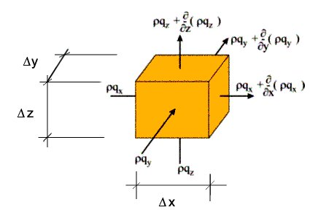

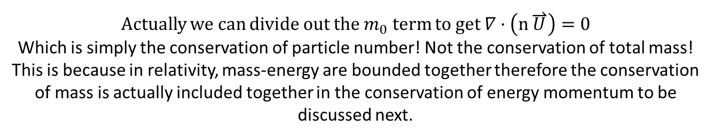
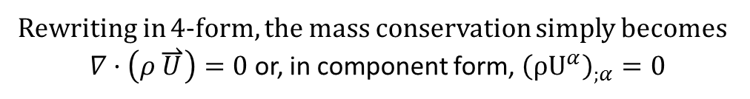
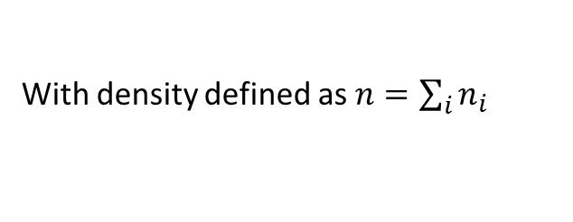
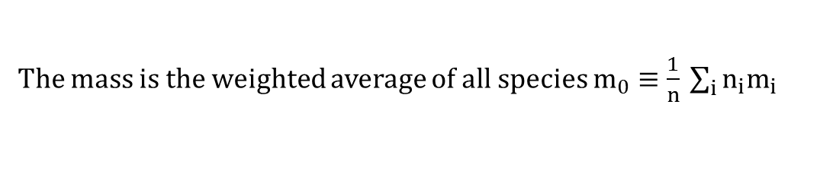
Conservation of Rest Mass
Mass conservation / continuity equation
As we did in class, we can for simplicity consider only a single type of particle that represents the weighted sum of all particles that are actually in the system.
The mass is the weighted average of all species $m_{0}≡\frac{1}{n}⁢\sum_{i}{n_{i}⁢m_{i}}$
With density defined as $n=\sum_{i}{n_{i}}$
Mass density then simply follows to be $ρ≡m_{0}⁢n$
Rewriting in 4-form, the mass conservation simply becomes
$∇·\left(ρ⁢\overset{⇀}{U}\right)=0$ or, in component form, ${\left({ρU}^{α}\right)}_{;α}=0$
Actually we can divide out the $m_{0}$ term to get $∇·\left(n\overset{⇀}{U}\right)=0$
Which is simply the conservation of particle number! Not the conservation of total mass! This is because in relativity, mass-energy are bounded together therefore the conservation of mass is actually included together in the conservation of energy momentum to be discussed next.

Slide 25
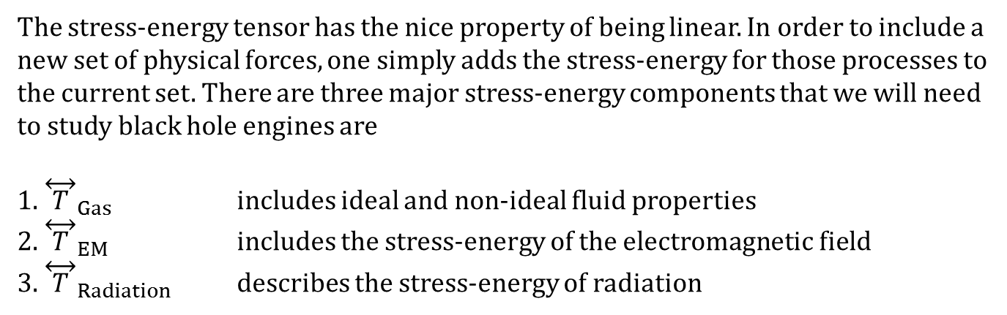
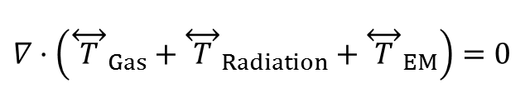
Overview of conservation of Energy-Momentum
The stress-energy tensor has the nice property of being linear. In order to include a
new set of physical forces, one simply adds the stress-energy for those processes to
the current set. There are three major stress-energy components that we will need
to study black hole engines are
1. ${\overset{⟷}{T}}_{Gas}$ includes ideal and non-ideal fluid properties
2. ${\overset{⟷}{T}}_{EM}$ includes the stress-energy of the electromagnetic field
3. ${\overset{⟷}{T}}_{Radiation}$ describes the stress-energy of radiation
Thus, the general conservation law reads as:
$$∇·\left({\overset{⟷}{T}}_{Gas}+{\overset{⟷}{T}}_{Radiation}+{\overset{⟷}{T}}_{EM}\right)=0$$
This conservation law will determine only four state variables: the temperature (from the energy conservation part) and the three spatial components of the four-velocity.
The time component of the four-velocity can be found from the normalization $U^{2}=−c^{2}$

Slide 26
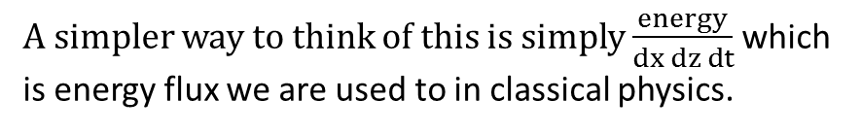
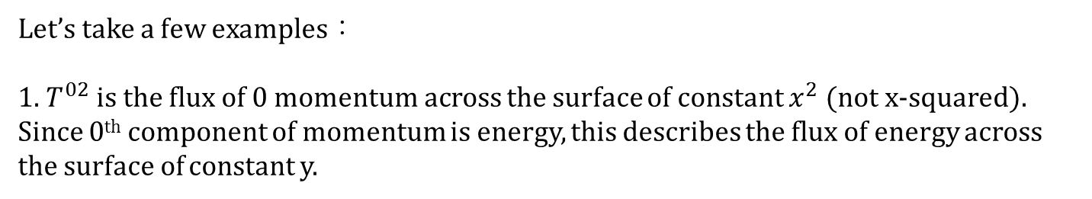
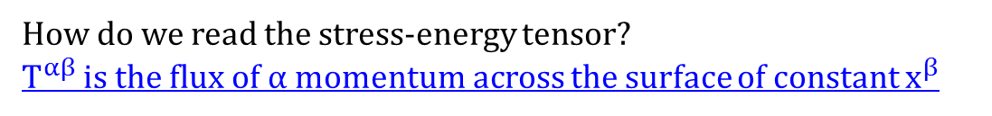
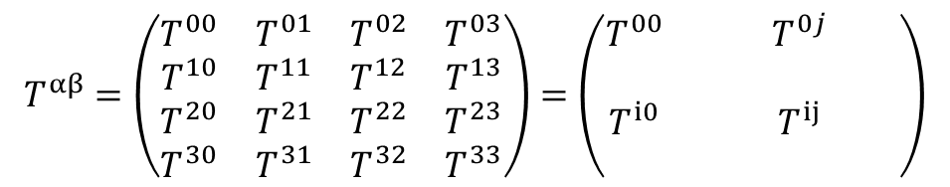
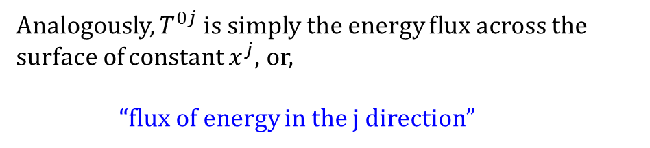
What is the Stress-Energy Tensor?
$$T^{αβ}=\left(\begin{matrix}T^{00} & T^{01} & T^{02} & T^{03} \\ T^{10} & T^{11} & T^{12} & T^{13} \\ T^{20} & T^{21} & T^{22} & T^{23} \\ T^{30} & T^{31} & T^{32} & T^{33}\end{matrix}\right)=\left(\begin{matrix}T^{00} & & T^{0⁢j} & \\ & & & \\ T^{i0} & & T^{ij} & \\ & & & \end{matrix}\right)$$
How do we read the stress-energy tensor?
$T^{αβ}$ is the flux of $α$ momentum across the surface of constant $x^{β}$
Let’s take a few examples：
1. $T^{02}$ is the flux of $0$ momentum across the surface of constant $x^{2}$ (not x-squared).
Since 0th component of momentum is energy, this describes the flux of energy across the surface of constant y.
A simpler way to think of this is simply $\frac{energy}{dx ⁢dz⁢ dt}$ which is energy flux we are used to in classical physics.
dz
dt
Analogously, $T^{0j}$ is simply the energy flux across the surface of constant $x^{j}$, or,
“flux of energy in the j direction”
dx
dy

Slide 27
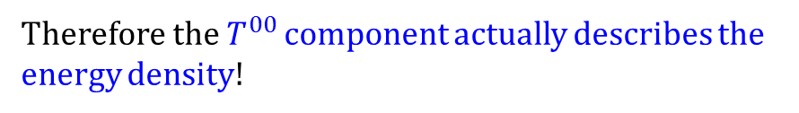
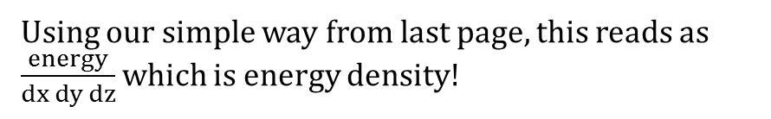
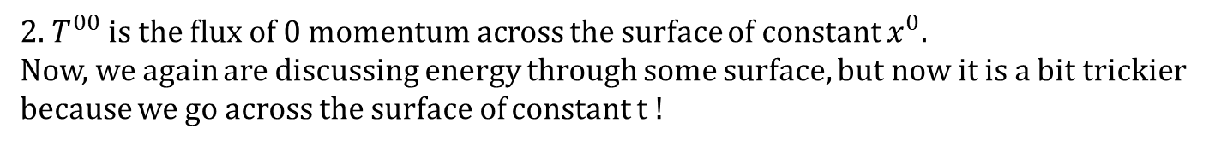
What is the Stress-Energy Tensor?
$$T^{αβ}=\left(\begin{matrix}T^{00} & T^{01} & T^{02} & T^{03} \\ T^{10} & T^{11} & T^{12} & T^{13} \\ T^{20} & T^{21} & T^{22} & T^{23} \\ T^{30} & T^{31} & T^{32} & T^{33}\end{matrix}\right)=\left(\begin{matrix}T^{00} & & T^{0⁢j} & \\ & & & \\ T^{i0} & & T^{ij} & \\ & & & \end{matrix}\right)$$
How do we read the stress-energy tensor?
$T^{αβ}$ is the flux of $α$ momentum across the surface of constant $x^{β}$
2. $T^{00}$ is the flux of $0$ momentum across the surface of constant $x^{0}$.
Now, we again are discussing energy through some surface, but now it is a bit trickier because we go across the surface of constant t !
Using our simple way from last page, this reads as $\frac{energy}{dx ⁢dy dz⁢}$ which is energy density!
dz
dx
Therefore the $T^{00}$ component actually describes the energy density!
dt

Slide 28
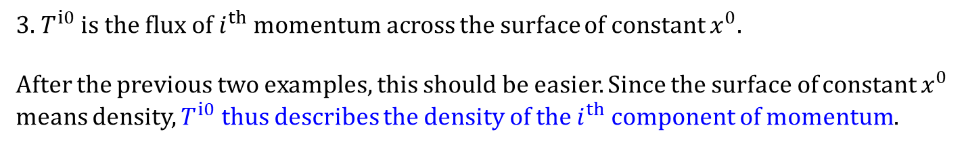
What is the Stress-Energy Tensor?
$$T^{αβ}=\left(\begin{matrix}T^{00} & T^{01} & T^{02} & T^{03} \\ T^{10} & T^{11} & T^{12} & T^{13} \\ T^{20} & T^{21} & T^{22} & T^{23} \\ T^{30} & T^{31} & T^{32} & T^{33}\end{matrix}\right)=\left(\begin{matrix}T^{00} & & T^{0⁢j} & \\ & & & \\ T^{i0} & & T^{ij} & \\ & & & \end{matrix}\right)$$
How do we read the stress-energy tensor?
$T^{αβ}$ is the flux of $α$ momentum across the surface of constant $x^{β}$
3. $T^{i0}$ is the flux of $i^{th}$ momentum across the surface of constant $x^{0}$.
After the previous two examples, this should be easier. Since the surface of constant $x^{0}$ means density, $T^{i0}$ thus describes the density of the $i^{th}$ component of momentum.
dz
dx
dt

Slide 29
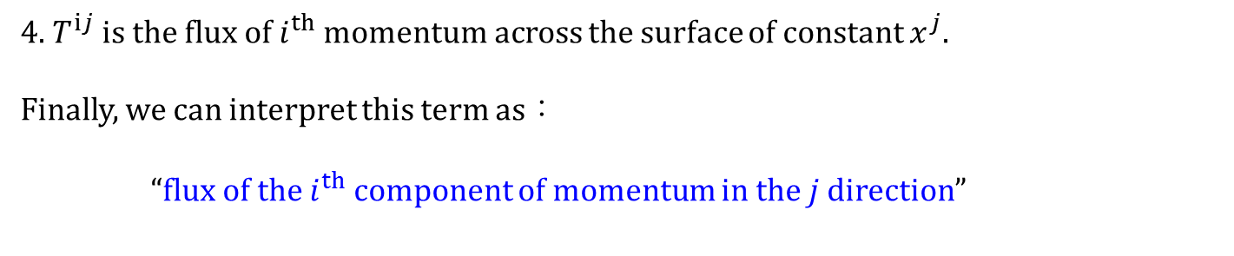
What is the Stress-Energy Tensor?
$$T^{αβ}=\left(\begin{matrix}T^{00} & T^{01} & T^{02} & T^{03} \\ T^{10} & T^{11} & T^{12} & T^{13} \\ T^{20} & T^{21} & T^{22} & T^{23} \\ T^{30} & T^{31} & T^{32} & T^{33}\end{matrix}\right)=\left(\begin{matrix}T^{00} & & T^{0⁢j} & \\ & & & \\ T^{i0} & & T^{ij} & \\ & & & \end{matrix}\right)$$
How do we read the stress-energy tensor?
$T^{αβ}$ is the flux of $α$ momentum across the surface of constant $x^{β}$
4. $T^{ij}$ is the flux of $i^{th}$ momentum across the surface of constant $x^{j}$.
Finally, we can interpret this term as：
“flux of the $i^{th}$ component of momentum in the $j$ direction”
dz
dt
dx
dy

Slide 30


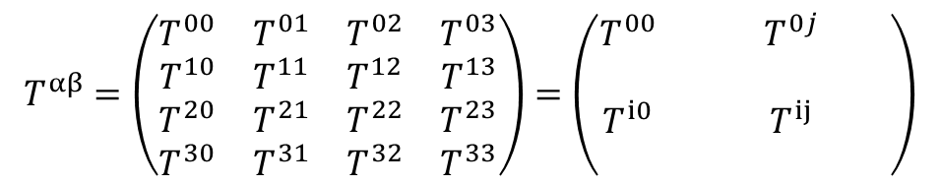



What is the Stress-Energy Tensor?
$$T^{αβ}=\left(\begin{matrix}T^{00} & T^{01} & T^{02} & T^{03} \\ T^{10} & T^{11} & T^{12} & T^{13} \\ T^{20} & T^{21} & T^{22} & T^{23} \\ T^{30} & T^{31} & T^{32} & T^{33}\end{matrix}\right)=\left(\begin{matrix}T^{00} & & T^{0⁢j} & \\ & & & \\ T^{i0} & & T^{ij} & \\ & & & \end{matrix}\right)$$
The stress-energy tensor is symmetric.
Energy
density
$$T^{0⁢j}$$
$$T^{00}$$
Energy flux
$$T^{αβ}=$$
$$T^{i0}$$
$$T^{ij}$$
Momentum
density
Momentum flux
If you forget everything else I talk about today, just bring this home with you!
It’s going to be a very useful concept guide for discussing all kinds of stress-energy tensors!

Slide 31
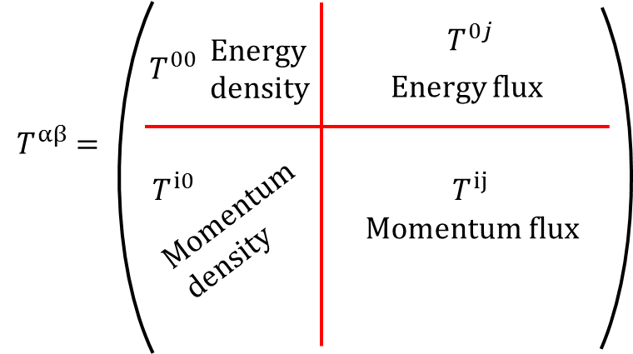
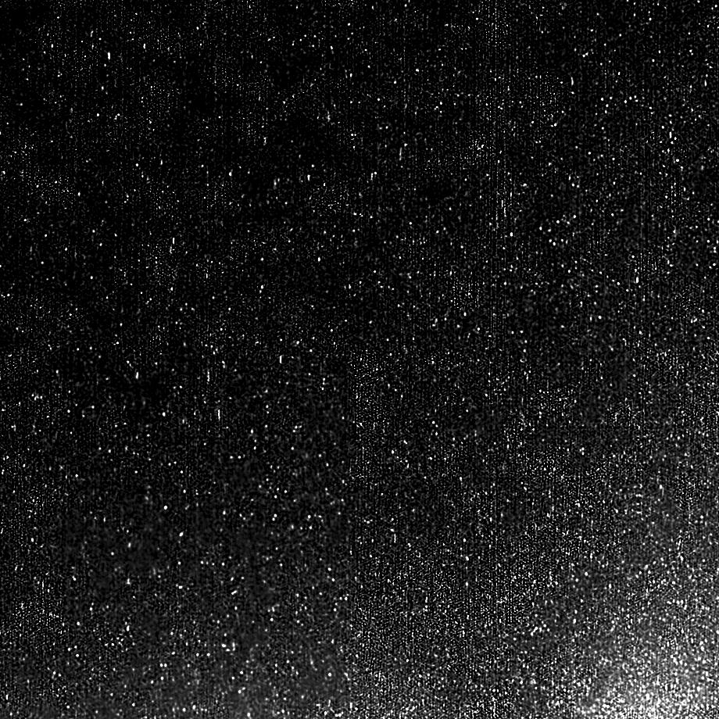
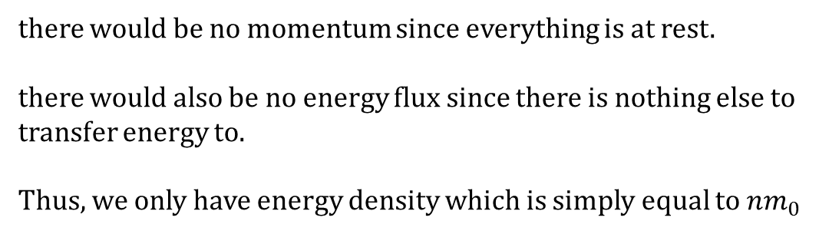
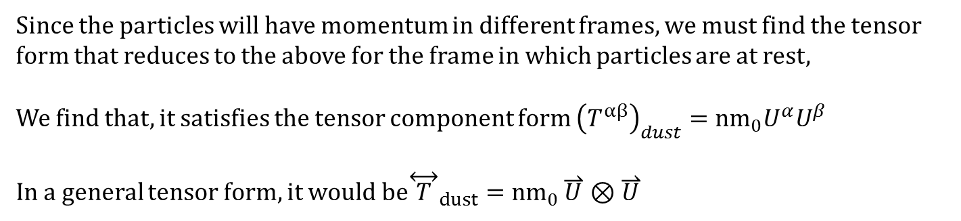
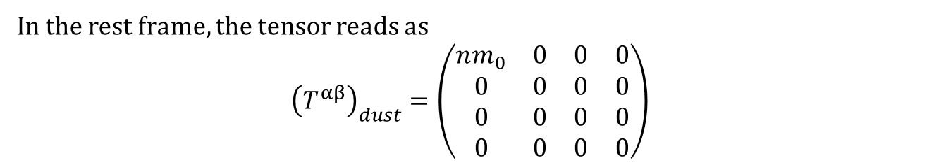
Basic Example -Dust
Consider a closed system only composed of particles moving together with no external field. In the rest frame of the particles,
there would be no momentum since everything is at rest.
there would also be no energy flux since there is nothing else to transfer energy to.
Thus, we only have energy density which is simply equal to $n⁢m_{0}$
In the rest frame, the tensor reads as
$${\left(T^{αβ}\right)}_{dust}=\left(\begin{matrix}n⁢m_{0} & 0 & 0 & 0 \\ 0 & 0 & 0 & 0 \\ 0 & 0 & 0 & 0 \\ 0 & 0 & 0 & 0\end{matrix}\right)$$
Since the particles will have momentum in different frames, we must find the tensor form that reduces to the above for the frame in which particles are at rest,
We find that, it satisfies the tensor component form ${\left(T^{αβ}\right)}_{dust}={nm}_{0}⁢U^{α}⁢U^{β}$
In a general tensor form, it would be${\overset{⟷}{T}}_{dust}={nm}_{0}⁢\overset{⇀}{U}⊗\overset{⇀}{U}$

Slide 32
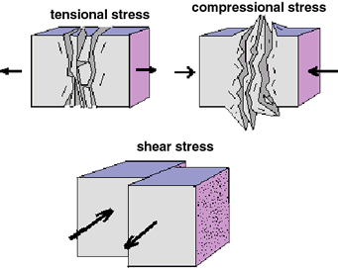
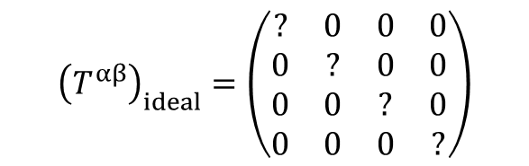
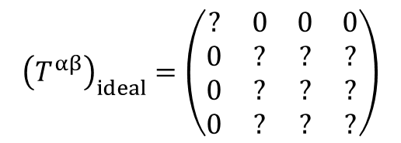
Ideal fluids
For ideal fluids, we don’t consider viscosity and heat transfer.
In the rest frame of a fluid element,
No heat transfer means that the energy flux term is zero, therefore momentum density is also zero.
$${\left(T^{αβ}\right)}_{ideal}=\left(\begin{matrix}? & 0 & 0 & 0 \\ 0 & ? & ? & ? \\ 0 & ? & ? & ? \\ 0 & ? & ? & ?\end{matrix}\right)$$
Having no viscosity (shear) says that the momentum can not be transported sideways, therefore we can only have diagonal terms.
Black arrows:
direction of momentum
Red arrows:
direction of momentum transport
$${\left(T^{αβ}\right)}_{ideal}=\left(\begin{matrix}? & 0 & 0 & 0 \\ 0 & ? & 0 & 0 \\ 0 & 0 & ? & 0 \\ 0 & 0 & 0 & ?\end{matrix}\right)$$

Slide 33
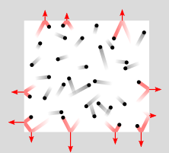
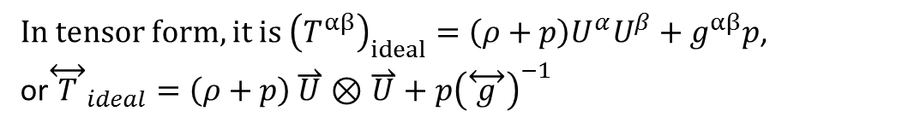
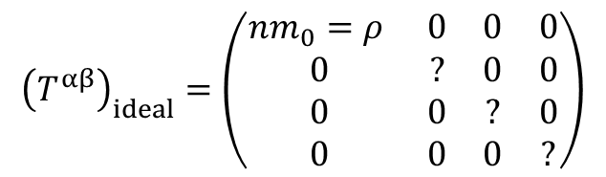
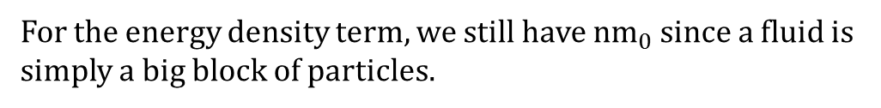
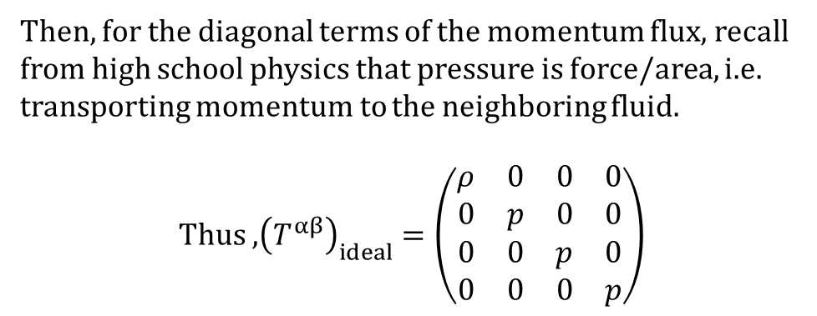

Ideal fluids
For the energy density term, we still have ${nm}_{0}$ since a fluid is simply a big block of particles.
$${\left(T^{αβ}\right)}_{ideal}=\left(\begin{matrix}n⁢m_{0}=ρ & 0 & 0 & 0 \\ 0 & ? & 0 & 0 \\ 0 & 0 & ? & 0 \\ 0 & 0 & 0 & ?\end{matrix}\right)$$
Then, for the diagonal terms of the momentum flux, recall from high school physics that pressure is force/area, i.e. transporting momentum to the neighboring fluid.
Thus ,${\left(T^{αβ}\right)}_{ideal}=\left(\begin{matrix}ρ & 0 & 0 & 0 \\ 0 & p & 0 & 0 \\ 0 & 0 & p & 0 \\ 0 & 0 & 0 & p\end{matrix}\right)$
In tensor form, it is ${\left(T^{αβ}\right)}_{ideal}=\left(ρ+p\right)⁢U^{α}⁢U^{β}+g^{αβ}⁢p$,
or${\overset{⟷}{T}}_{ideal}=\left(ρ+p\right)⁢\overset{⇀}{U}⊗\overset{⇀}{U}+p⁢{\left(\overset{⟷}{g}\right)}^{−1}$
$${\overset{⟷}{T}}_{dust}={nm}_{0}⁢\overset{⇀}{U}⊗\overset{⇀}{U}$$
It’s easy to see that if we remove the pressure, then it reduces to the dust case.
Notes:
Why does the internal energy term missing
Compare with Meier

Slide 34





Conservation laws
Before we continue into more complicated (and extremely complicated) tensors,
Let’s look at how the stress-energy tensors actually have the conservation laws and the equations of motion embedded in them.
Let’s look again at this form:
Compare that to the conservation of charge we learned in undergrad.
$\frac{∂ρ}{∂t}+\overset{⇀}{∇}·\overset{⇀}{J}=0$
3-divergence
It should be clear that density and flux are related through the conservation law. Thus,
$$\frac{∂ (energy ⁢density)}{∂t}+\overset{⇀}{∇}·\overset{⇀}{energy⁢ flux}=0$$
${T^{αβ}}_{;β}=0$ or $\overset{⇀}{∇}·\overset{⟷}{T}=0$
$$\frac{∂ (momentum density)}{∂t}+\overset{⇀}{∇}·\overset{⇀}{momentum ⁢flux}=0$$

Slide 35




Equation of motion
Consider the stress energy tensor of ideal fluid ${\left(T^{αβ}\right)}_{ideal}=\left(\begin{matrix}ρ & 0 & 0 & 0 \\ 0 & p & 0 & 0 \\ 0 & 0 & p & 0 \\ 0 & 0 & 0 & p\end{matrix}\right)$
Using the conservation law ${T^{αβ}}_{;β}=0$, we can derive the equation of motion for a relativistic fluid.
The derivation is 2~3 pages in Schutz and I don’t intend to explain through the math.
The end result of using ‘a bit of algebra’
$\left(ρ+p\right)⁢a_{i}+p_{,i}=0$ or, more concisely, $\left(ρ+p\right)⁢\overset{⇀}{a}=−\overset{⇀}{∇}p$ (3-vectors)
This is very similar to the expression we obtained in plasma astrophysics $ρ⁢\overset{⇀}{a}=−\overset{⇀}{∇}p$
: the fluid is being driven by pressure gradients.
The only difference is the inertial term in from of the acceleration. Having an additional ‘p’ term in the inertia.

Slide 36



Equation of motion
$\left(ρ+p\right)⁢\overset{⇀}{a}=−\overset{⇀}{∇}p$
How do we rationalize this additional pressure term?
Recall that for relativistic stuff, the inertia not only contains rest mass, but also the kinetic energy— it is the mass-energy that determines how hard something is to accelerate.
Therefore, an easy way to think of this is to recall that pressure is actually caused by the random kinetic motion within a fluid, meaning that pressure, being kinetic motion by origin, adds to the inertia.
For non-relativistic situations, inertia is dominated by rest mass, thus $ρ≫p$ and the equation reduces to $ρ⁢\overset{⇀}{a}=−\overset{⇀}{∇}p$ as we expect.

Slide 37
Before we continue…
Now that it has been demonstrated that the stress-energy tensor relates to the equations of motion through conservation laws, we are now in place to proceed with more messy forms of the stress-energy tensor.
Next, we will derive, or show the stress-energy tensors for various cases:
1. General fluids/gas with viscosity and heat conduction
2. Photon gases
3. Electromagnetic fields

Slide 38


Full Stress-Energy Tensor for a Perfect Gas
Similar to that of an ideal gas we argued for earlier, we now include the consideration of internal energy of particles and find that, in the local frame of the fluid element, the stress-energy tensor reads as
$${\left(T^{αβ}\right)}_{fluid}=\left(\begin{matrix}ρ+ε & 0 & 0 & 0 \\ 0 & p & 0 & 0 \\ 0 & 0 & p & 0 \\ 0 & 0 & 0 & p\end{matrix}\right)$$
And the general tensor form to be
$${T^{αβ}}_{fluid}=\left(ρ+\frac{ε_{g}+p_{g}}{c^{2}}\right)⁢U^{α}⁢U^{β}+p_{g}⁢g^{αβ}$$

Slide 39


Heat Conduction
The above stress-energy tensor is sufﬁcient to describe the ﬂuid or gas as long as the mean free path of particles in the ﬂuid is very short compared to the distance over which thermal and kinetic properties of the ﬂuid change.
However, if hot particles can travel long distances and deposit their heat in a cooler region of the ﬂuid, then we must take this heat conduction into account.
This tells us that we are now discussing the energy flux/momentum density terms.
From classical physics, we have learned that for conduction of heat,
The heat flux is proportional to temperature gradient. Or, formally,
$${\overset{⇀}{Q}}_{g}=−K_{c}⁢\overset{⇀}{∇}T$$

Slide 40



Heat Conduction : From 3D to 4D
With the knowledge that ${\overset{⇀}{Q}}_{g}=−K_{c}⁢\overset{⇀}{∇}T$ and that it corresponds to the $T^{i0}$and $T^{0j}$ terms, we could guess that in locally flat space-time, the components would read as
$${\left(T^{αβ}\right)}_{Conduction}=\left(\begin{matrix}0 & Q_{g}^{x} & Q_{g}^{y} & Q_{g}^{z} \\ Q_{g}^{x} & 0 & 0 & 0 \\ Q_{g}^{y} & 0 & 0 & 0 \\ Q_{g}^{z} & 0 & 0 & 0\end{matrix}\right)$$
However, we can see that $Q_{g}^{}$ is actually still a 3-vector and the above form is simply from an educated guess. Therefore we need to first rewrite $Q_{g}^{}$ into a 4-vector $Q_{g}^{α}$.
We find that it can be expressed as
$Q_{g}^{α}=−K_{c}⁢\left(c^{2}⁢P^{αβ}⁢∇_{β}T+T⁢U^{β}⁢∇_{β}U^{α}\right)$ with $P^{αβ}=\frac{1}{c^{2}}⁢U^{α}⁢U^{β}+g^{αβ}$
4-acceleration (how to explain?)
Or, ${\overset{⇀}{Q}}_{g}=−K_{c}⁢\left(c^{2}⁢\overset{⟷}{P}·\overset{⇀}{∇}T+T⁢\overset{⇀}{U}·\overset{⇀}{∇}\overset{⇀}{U}\right)$ with $\overset{⟷}{P}=\frac{1}{c^{2}}⁢\overset{⇀}{U}⊗\overset{⇀}{U}+{\left(\overset{⟷}{g}\right)}^{−1}$

Slide 41



Heat Conduction : From 3D to 4D
Let’s demonstrate that $Q_{g}^{α}=−K_{c}⁢\left(c^{2}⁢P^{αβ}⁢∇_{β}T+T⁢U^{β}⁢∇_{β}U^{α}\right)$ with $P^{αβ}=\frac{1}{c^{2}}⁢U^{α}⁢U^{β}+g^{αβ}$ does indeed reduce to the 3D case ${\overset{⇀}{Q}}_{g}=−K_{c}⁢\overset{⇀}{∇}T$
In the local frame, $U^{α}=\left(\begin{matrix}c \\ 0 \\ 0 \\ 0\end{matrix}\right)$ and $g^{αβ}=η^{αβ}=\left(\begin{matrix}−1 & 0 & 0 & 0 \\ 0 & 1 & 0 & 0 \\ 0 & 0 & 1 & 0 \\ 0 & 0 & 0 & 1\end{matrix}\right)$ Thus, $c^{2}P^{αβ}=\left(\begin{matrix}0 & 0 & 0 & 0 \\ 0 & 1 & 0 & 0 \\ 0 & 0 & 1 & 0 \\ 0 & 0 & 0 & 1\end{matrix}\right)$
As $U^{α}$ contain only constants, $∇_{β}U^{α}$simply vanishes.
Finally,
$$\left(\begin{matrix}Q_{g}^{t} \\ Q_{g}^{x} \\ Q_{g}^{y} \\ Q_{g}^{z}\end{matrix}\right)=Q_{g}^{α}=−K_{c}⁢\left(c^{2}⁢P^{αβ}⁢∇_{β}T\right)=−K_{c}⁢\left(\begin{matrix}0 & 0 & 0 & 0 \\ 0 & 1 & 0 & 0 \\ 0 & 0 & 1 & 0 \\ 0 & 0 & 0 & 1\end{matrix}\right)⁢\left(\begin{matrix}\frac{∂T}{∂t} \\ \frac{∂T}{∂x} \\ \frac{∂T}{∂y} \\ \frac{∂T}{∂z}\end{matrix}\right)=−K_{c}⁢\left(\begin{matrix}0 \\ \frac{∂T}{∂x} \\ \frac{∂T}{∂y} \\ \frac{∂T}{∂z}\end{matrix}\right)$$
We find that we indeed recover ${\overset{⇀}{Q}}_{g}=−K_{c}⁢\overset{⇀}{∇}T$ in this frame.

Slide 42







The projection tensor
Just now we have defined this tensor $P^{αβ}=\frac{1}{c^{2}}⁢U^{α}⁢U^{β}+g^{αβ}$ without explaining how it behaves. In the following we will demonstrate that it is a projection tensor, and what it does is to “project out the component of a tensor that is orthogonal to $U^{α}$, the 4-velocity”
Let’s consider a random tensor $Z^{γδθϕ}$, the projection is $P^{αβ}Z^{γδθϕ}$ as illustrated below.
Any tensor
Tensor perpendicular to 4-velocity
Tensor along 4-velocity
4-velocity
$$Z^{γδθϕ}$$
$$P^{αβ}Z^{γδθϕ}$$
Tensor perpendicular to 4-velocity
Tensor along 4-velocity
Taking the dot product with the 4-velocity,
4-velocity
$$−c^{2}$$
$$\left(U_{α}⁢P^{αβ}\right)⁢Z^{γδθϕ}=\left(\frac{1}{c^{2}}U_{α}⁢U^{α}⁢U^{β}+g^{αβ}U_{α}\right)Z^{γδθϕ}$$
$=\left(−U^{β}+U^{β}\right)Z^{γδθϕ}=0$！
We see that it is 0 no matter what odd tensor we use!

Slide 43




Completing the heat conduction tensor
$${\left(T^{αβ}\right)}_{Conduction}=\left(\begin{matrix}0 & Q_{g}^{x} & Q_{g}^{y} & Q_{g}^{z} \\ Q_{g}^{x} & 0 & 0 & 0 \\ Q_{g}^{y} & 0 & 0 & 0 \\ Q_{g}^{z} & 0 & 0 & 0\end{matrix}\right)$$
Heat conduction vector $Q_{g}^{α}=−K_{c}⁢\left(c^{2}⁢P^{αβ}⁢∇_{β}T+T⁢U^{β}⁢∇_{β}U^{α}\right)$
Projection tensor $P^{αβ}=\frac{1}{c^{2}}⁢U^{α}⁢U^{β}+g^{αβ}$
Finally, we find that a viable tensor that reduces to the above components in the locally flat frame is
$${T^{αβ}}_{Conduction}=\frac{1}{c^{2}}⁢\left(Q_{g}^{α}⁢U^{β}+U^{α}⁢Q_{g}^{β}\right)$$
$${\overset{⟷}{T}}_{Conduction}=\frac{1}{c^{2}}⁢\left({\overset{⇀}{Q}}_{g}⊗\overset{⇀}{U}+\overset{⇀}{U}⊗{\overset{⇀}{Q}}_{g}\right)$$
$${T^{αβ}}_{Conduction}=\frac{1}{c^{2}}⁢\left(Q_{g}^{α}⁢U^{β}+U^{α}⁢Q_{g}^{β}\right)=\frac{1}{c}⁢\left(\left(\begin{matrix}0 & 0 & 0 & 0 \\ Q_{g}^{x} & 0 & 0 & 0 \\ Q_{g}^{y} & 0 & 0 & 0 \\ Q_{g}^{z} & 0 & 0 & 0\end{matrix}\right)+\left(\begin{matrix}0 & Q_{g}^{x} & Q_{g}^{y} & Q_{g}^{z} \\ 0 & 0 & 0 & 0 \\ 0 & 0 & 0 & 0 \\ 0 & 0 & 0 & 0\end{matrix}\right)\right)$$

Slide 44




Heat conduction tensor: Summary
Heat conduction tensor ${T^{αβ}}_{Conduction}=\frac{1}{c^{2}}⁢\left(Q_{g}^{α}⁢U^{β}+U^{α}⁢Q_{g}^{β}\right)$
Heat conduction vector $Q_{g}^{α}=−K_{c}⁢\left(c^{2}⁢P^{αβ}⁢∇_{β}T+T⁢U^{β}⁢∇_{β}U^{α}\right)$
Projection tensor $P^{αβ}=\frac{1}{c^{2}}⁢U^{α}⁢U^{β}+g^{αβ}$
In the locally flat frame, ${\left(T^{αβ}\right)}_{Conduction}=\left(\begin{matrix}0 & Q_{g}^{x} & Q_{g}^{y} & Q_{g}^{z} \\ Q_{g}^{x} & 0 & 0 & 0 \\ Q_{g}^{y} & 0 & 0 & 0 \\ Q_{g}^{z} & 0 & 0 & 0\end{matrix}\right)$
The moving body frame (MOV)

Slide 45

Viscosity
Another related process that arises because of long particle mean free paths is viscosity; this transports momentum rather than energy. Two kinds of viscosity are recognized: shear and bulk. Shear viscosity transports momentum perpendicular to the ﬂuid ﬂow, and bulk viscosity does so parallel to the ﬂow.

Slide 46






Viscosity stress-energy component
Since viscosity works to transport momentum, it should manifest itself in the momentum flux term of the tensor.
I’m not so familiar with this part so below mainly follows the textbook.
$${T^{αβ}}_{Viscosity}=−2⁢η_{v,g}⁢Σ^{αβ}−ζ_{v,g}⁢Θ⁢P^{αβ}$$
Shear viscosity coefficient
$$η_{v,g}=η_{v,g}⁢\left(ρ,T\right)⁢$$
shear
bulk
Projection tensor $P^{αβ}=\frac{1}{c^{2}}⁢U^{α}⁢U^{β}+g^{αβ}$
Bulk viscosity coefficient
$$ζ_{v,g}=ζ_{v,g}⁢\left(ρ,T\right)$$
Shear tensor $Σ^{αβ}≡\left.\frac{1}{2}[P^{αγ}⁢∇_{γ}U^{β}+P^{βγ}⁢∇_{γ}U^{α}\right]−\frac{1}{3}⁢Θ⁢P^{αβ}$
Compression rate $Θ≡∇_{γ}U^{γ}$

Slide 47



$${\left(T^{αβ}\right)}_{Viscosity}=\left(\begin{matrix}0 & 0 & 0 & 0 \\ 0 & −2⁢η_{v,g}⁢Σ^{xx}−ζ_{v,g}⁢Θ & −2⁢η_{v,g}⁢Σ^{xy} & −2⁢η_{v,g}⁢Σ^{xz} \\ 0 & −2⁢η_{v,g}⁢Σ^{yx} & −2⁢η_{v,g}⁢Σ^{yy}−ζ_{v,g}⁢Θ & −2⁢η_{v,g}⁢Σ^{yz} \\ 0 & −2⁢η_{v,g}⁢Σ^{zx} & −2⁢η_{v,g}⁢Σ^{zy} & −2⁢η_{v,g}⁢Σ^{zz}−ζ_{v,g}⁢Θ\end{matrix}\right)$$
$${\left(T^{αβ}\right)}_{fluid}=\left(\begin{matrix}ρ+ε & 0 & 0 & 0 \\ 0 & p & 0 & 0 \\ 0 & 0 & p & 0 \\ 0 & 0 & 0 & p\end{matrix}\right)$$

Slide 48



Viscous Heating
$${\left(T^{αβ}\right)}_{Viscosity}=\left(\begin{matrix}0 & 0 & 0 & 0 \\ 0 & −2⁢η_{v,g}⁢Σ^{xx}−ζ_{v,g}⁢Θ & −2⁢η_{v,g}⁢Σ^{xy} & −2⁢η_{v,g}⁢Σ^{xz} \\ 0 & −2⁢η_{v,g}⁢Σ^{yx} & −2⁢η_{v,g}⁢Σ^{yy}−ζ_{v,g}⁢Θ & −2⁢η_{v,g}⁢Σ^{yz} \\ 0 & −2⁢η_{v,g}⁢Σ^{zx} & −2⁢η_{v,g}⁢Σ^{zy} & −2⁢η_{v,g}⁢Σ^{zz}−ζ_{v,g}⁢Θ\end{matrix}\right)$$
$${\left(T^{αβ}\right)}_{fluid}=\left(\begin{matrix}ρ+ε & 0 & 0 & 0 \\ 0 & p & 0 & 0 \\ 0 & 0 & p & 0 \\ 0 & 0 & 0 & p\end{matrix}\right)$$

Slide 49





Full stress-energy tensor for gas
$${T^{αβ}}_{gas}={T^{αβ}}_{fluid}+{T^{αβ}}_{Conduction}+{T^{αβ}}_{Viscosity}=\left(\left(ρ+p+\frac{ε}{c^{2}}\right)⁢U^{α}⁢U^{β}+g^{αβ}⁢p \right)+\left(\frac{1}{c^{2}}⁢\left(Q_{g}^{α}⁢U^{β}+U^{α}⁢Q_{g}^{β}\right)\right)+\left(−2⁢η_{v,g}⁢Σ^{αβ}−ζ_{v,g}⁢Θ⁢P^{αβ}\right)$$
$${\left(T^{αβ}\right)}_{fluid}=\left(\begin{matrix}ρ+ε & 0 & 0 & 0 \\ 0 & p & 0 & 0 \\ 0 & 0 & p & 0 \\ 0 & 0 & 0 & p\end{matrix}\right)$$
$${\left(T^{αβ}\right)}_{Conduction}=\left(\begin{matrix}0 & Q_{g}^{x} & Q_{g}^{y} & Q_{g}^{z} \\ Q_{g}^{x} & 0 & 0 & 0 \\ Q_{g}^{y} & 0 & 0 & 0 \\ Q_{g}^{z} & 0 & 0 & 0\end{matrix}\right)$$
$${\left(T^{αβ}\right)}_{Viscosity}=\left(\begin{matrix}0 & 0 & 0 & 0 \\ 0 & −2⁢η_{v,g}⁢Σ^{xx}−ζ_{v,g}⁢Θ & −2⁢η_{v,g}⁢Σ^{xy} & −2⁢η_{v,g}⁢Σ^{xz} \\ 0 & −2⁢η_{v,g}⁢Σ^{yx} & −2⁢η_{v,g}⁢Σ^{yy}−ζ_{v,g}⁢Θ & −2⁢η_{v,g}⁢Σ^{yz} \\ 0 & −2⁢η_{v,g}⁢Σ^{zx} & −2⁢η_{v,g}⁢Σ^{zy} & −2⁢η_{v,g}⁢Σ^{zz}−ζ_{v,g}⁢Θ\end{matrix}\right)$$
$${\left(T^{αβ}\right)}_{gas}=\left(\begin{matrix}{ρc}^{2}+ε_{g} & Q_{g}^{x} & Q_{g}^{y} & Q_{g}^{z} \\ Q_{g}^{x} & −2⁢η_{v,g}⁢Σ^{xx}−ζ_{v,g}⁢Θ+p_{g} & −2⁢η_{v,g}⁢Σ^{xy} & −2⁢η_{v,g}⁢Σ^{xz} \\ Q_{g}^{y} & −2⁢η_{v,g}⁢Σ^{yx} & −2⁢η_{v,g}⁢Σ^{yy}−ζ_{v,g}⁢Θ+p_{g} & −2⁢η_{v,g}⁢Σ^{yz} \\ Q_{g}^{z} & −2⁢η_{v,g}⁢Σ^{zx} & −2⁢η_{v,g}⁢Σ^{zy} & −2⁢η_{v,g}⁢Σ^{zz}−ζ_{v,g}⁢Θ+p_{g}\end{matrix}\right)$$

Slide 50





Radiation dynamics
In many situations that we will study in the next few chapters, the fluid will be optically thick to radiation and both will be in thermodynamic equilibrium at the same temperature $T_{r}=T_{g}≡T$.
In this case the photon gas will contribute to the fluid plasma pressure, energy density, heat conduction, and viscosity and will add stress-energy terms similar to those discussed previously for fluids.
$${\left(T^{αβ}\right)}_{gas}=\left(\begin{matrix}{ρc}^{2}+ε_{g} & Q_{g}^{x} & Q_{g}^{y} & Q_{g}^{z} \\ Q_{g}^{x} & −2⁢η_{v,g}⁢Σ^{xx}−ζ_{v,g}⁢Θ+p_{g} & −2⁢η_{v,g}⁢Σ^{xy} & −2⁢η_{v,g}⁢Σ^{xz} \\ Q_{g}^{y} & −2⁢η_{v,g}⁢Σ^{yx} & −2⁢η_{v,g}⁢Σ^{yy}−ζ_{v,g}⁢Θ+p_{g} & −2⁢η_{v,g}⁢Σ^{yz} \\ Q_{g}^{z} & −2⁢η_{v,g}⁢Σ^{zx} & −2⁢η_{v,g}⁢Σ^{zy} & −2⁢η_{v,g}⁢Σ^{zz}−ζ_{v,g}⁢Θ+p_{g}\end{matrix}\right)$$
$ρ=ρ_{g}$ Total density of fluid (photons don’t contribute to this)
$p=p_{g}+p_{r}$ Total pressure
$ε=ε_{g}+ε_{r}$ Total energy density
$Q^{α}={Q_{g}}^{α}+{Q_{r}}^{α}$ Total heat conduction vector
$η_{v}=η_{v,g}+η_{v,r}$ Total coefficient of shear viscosity
$ζ_{v}=ζ_{v,g}+ζ_{v,r}$ Total coefficient of bulk viscosity

Slide 51



Heat conduction in case of photons
Previously, for matter, heat conduction is computed from temperature gradients. $Q_{g}^{α}=−K_{c}⁢\left(c^{2}⁢P^{αβ}⁢∇_{β}T+T⁢U^{β}⁢∇_{β}U^{α}\right)$
In the case of radiation, the heat flux is computed from the radiative pressure and enthalpy, rather than from temperature.
Often, the heat flux is a function of frequency (this will be talked about next week), therefore we need to integrate over different frequencies.
$${Q_{r}}^{α}=\int_{0}^{∞}{\frac{∂{Q_{r}}^{α}⁢\left(ν\right)}{∂ν}⁢dν}$$
$$\frac{∂{Q_{r}}^{α}⁢\left(ν\right)}{∂ν}=−\frac{1}{κ⁢\left(ν\right)⁢ρc}⁢\left\{c^{2}⁢P^{αβ}·∇_{β}p_{r}⁢\left(ν\right)+\left[ε_{r}⁢\left(ν\right)+p_{r}⁢\left(ν\right)\right]⁢U^{γ}·∇_{γ}U^{α}\right\}$$
$κ⁢\left(ν\right)⁢$is the opacity of the specific frequency.
$κ⁢\left(ν\right)⁢ρ$ is the absorption coefficient

Slide 52





Mean opacities of photons
$$\frac{1}{{\overset{–}{κ}}_{R}}=\frac{\int_{0}^{∞}{\frac{1}{κ⁢\left(ν\right)}⁢\frac{∂p_{r}⁢\left(ν\right)}{∂T}⁢dν}}{\int_{0}^{∞}{\frac{∂p_{r}⁢\left(ν\right)}{∂T}⁢dν}}$$
$$\frac{1}{{\overset{–}{κ}′}_{R}}=\frac{\int_{0}^{∞}{\left.\frac{1}{κ⁢\left(ν\right)}[ε_{r}⁢\left(ν\right)+p_{r}⁢\left(ν\right)\right]⁢dν}}{\int_{0}^{∞}{ε_{r}⁢\left(ν\right)}+p_{r}⁢\left(ν\right)⁢dν}$$
$${Q_{r}}^{α}=−\left.\frac{c}{{\overset{–}{κ}}_{R}⁢ρ}[P^{αβ}⁢∇_{β}p_{r}\right]−\left.\frac{1}{{\overset{–}{κ}′}_{R}}[\left(ε_{r}⁢\left(ν\right)+p_{r}⁢\left(ν\right)\right)⁢U^{γ}·∇_{γ}U^{α}\right]$$

Slide 53


Stress-energy tensor for radiation in the rest frame
$${T^{αβ}}_{rad}=\left(\left(\frac{ε_{r}}{c^{2}}+p_{r}\right)⁢U^{α}⁢U^{β}+g^{αβ}⁢p\right)+\left(\frac{1}{c^{2}}⁢\left(Q_{r}^{α}⁢U^{β}+U^{α}⁢Q_{r}^{β}\right)\right)+\left(−2⁢η_{v,r}⁢Σ^{αβ}−ζ_{v,r}⁢Θ⁢P^{αβ}\right)$$
In the rest frame, we it can be expressed, very similarly to that for gas, as
$${\left(T^{αβ}\right)}_{rad}=\left(\begin{matrix}ε_{r} & Q_{r}^{x} & Q_{r}^{y} & Q_{r}^{z} \\ Q_{r}^{x} & −2⁢η_{v,r}⁢Σ^{xx}−ζ_{v,r}⁢Θ+p_{r} & −2⁢η_{v,r}⁢Σ^{xy} & −2⁢η_{v,r}⁢Σ^{xz} \\ Q_{r}^{y} & −2⁢η_{v,r}⁢Σ^{yx} & −2⁢η_{v,r}⁢Σ^{yy}−ζ_{v,r}⁢Θ+p_{r} & −2⁢η_{v,r}⁢Σ^{yz} \\ Q_{r}^{z} & −2⁢η_{v,r}⁢Σ^{zx} & −2⁢η_{v,r}⁢Σ^{zy} & −2⁢η_{v,r}⁢Σ^{zz}−ζ_{v,r}⁢Θ+p_{r}\end{matrix}\right)$$
For comparison,
$${\left(T^{αβ}\right)}_{gas}=\left(\begin{matrix}{ρc}^{2}+ε_{g} & Q_{g}^{x} & Q_{g}^{y} & Q_{g}^{z} \\ Q_{g}^{x} & −2⁢η_{v,g}⁢Σ^{xx}−ζ_{v,g}⁢Θ+p_{g} & −2⁢η_{v,g}⁢Σ^{xy} & −2⁢η_{v,g}⁢Σ^{xz} \\ Q_{g}^{y} & −2⁢η_{v,g}⁢Σ^{yx} & −2⁢η_{v,g}⁢Σ^{yy}−ζ_{v,g}⁢Θ+p_{g} & −2⁢η_{v,g}⁢Σ^{yz} \\ Q_{g}^{z} & −2⁢η_{v,g}⁢Σ^{zx} & −2⁢η_{v,g}⁢Σ^{zy} & −2⁢η_{v,g}⁢Σ^{zz}−ζ_{v,g}⁢Θ+p_{g}\end{matrix}\right)$$

Slide 54

Electrodynamic stress-energy
Recall that the basic structure of the stress-energy tensor looks like this
As we learned in the Electromagnetics (chap. 8 of Griffiths), there are two conservation laws
1. Conservation of energy – Electromagnetic fields does work on the charges via the electric field $\frac{dW}{dt}=\int{\left(\overset{⇀}{E}·\overset{⇀}{J}\right)⁢dV}$
After some derivation, we arrive at the formula
$$\frac{∂\left(u_{EM}+u_{Mech}\right)}{∂t}+\overset{⇀}{∇}·\overset{⇀}{S}=0$$
The sum of energy density of the system (particles+fields) and the Poynting flux is conserved.
We can see that this is the top row of the tensor.

Slide 55


Electrodynamic stress-energy
2. Conservation of momentum– Electromagnetic fields affect charged particles through the Lorentz force $\overset{⇀}{F}=q⁢\left(\overset{⇀}{E}+\frac{\overset{⇀}{v}×\overset{⇀}{B}}{c}\right)$
Again, after some derivation, we find
$${\overset{⇀}{f}}_{mech}−\overset{⇀}{∇}·{\overset{⟷}{T}}_{maxwell}+\frac{1}{c}⁢\frac{∂\overset{⇀}{S}}{∂t}=0$$
With the Maxwell Tensor defined as $T_{ij}=\left.\frac{1}{4⁢π}[\left(E_{i}⁢E_{j}−\frac{1}{2}⁢δ_{ij}⁢E^{2}\right)+\left(B_{i}⁢B_{j}−\frac{1}{2}⁢δ_{ij}⁢B^{2}\right)\right]$
This says that the sum of momentum contained in the system(particles+fields) and the momentum carried by Poynting flux is conserved.
Here, it should be clear that it corresponds to the bottom 3 rows.

Slide 56

The electrodynamic tensor
Conservation of energy (3-form) $\frac{∂\left(u_{EM}+u_{Mech}\right)}{∂t}+\overset{⇀}{∇}·\overset{⇀}{S}=0$
Conservation of momentum (3-form) ${\overset{⇀}{f}}_{mech}−\overset{⇀}{∇}·{\overset{⟷}{T}}_{maxwell}+\frac{1}{c}⁢\frac{∂\overset{⇀}{S}}{∂t}=0$
Combining the two conservation laws which were written in 3-form (consider the EM part), and utilizing the Faraday tensor that was introduced a few weeks ago,
The tensor reads as
$${\left(T^{αβ}\right)}_{EM}=\left.\frac{1}{4⁢π}[F^{αγ}⁢{F^{β}}_{γ}−\frac{1}{4}⁢g^{αβ}⁢F^{μν}⁢F_{μν}\right]$$
The faraday tensor $F^{αβ}=\left(\begin{matrix}0 & E_{x} & E_{y} & E_{z} \\ −E_{x} & 0 & B_{z} & −B_{y} \\ −E_{y} & −B_{z} & 0 & B_{x} \\ −E_{z} & B_{y} & −B_{x} & 0\end{matrix}\right)$

Slide 57




The electrodynamic tensor
$${\left(T^{αβ}\right)}_{EM}=\left.\frac{1}{4⁢π}[F^{αγ}⁢{F^{β}}_{γ}−\frac{1}{4}⁢g^{αβ}⁢F^{μν}⁢F_{μν}\right]$$
In the rest frame of the fluid, the tensor components read as:
$${\left(T^{αβ}\right)}_{EM}=\left(\begin{matrix}ε_{em} & Q_{em}^{x} & Q_{em}^{y} & Q_{em}^{z} \\ Q_{em}^{x} & −\left.\frac{1}{4⁢π}[{\left(E^{x}\right)}^{2}+{\left(B^{x}\right)}^{2}\right]+p_{em} & −\frac{1}{4⁢π}⁢\left(E^{x}⁢E^{y}+B^{x}⁢B^{y}\right) & −\frac{1}{4⁢π}⁢\left(E^{x}⁢E^{x}+B^{x}⁢B^{z}\right) \\ Q_{em}^{y} & −\frac{1}{4⁢π}⁢\left(E^{x}⁢E^{y}+B^{x}⁢B^{y}\right) & −\left.\frac{1}{4⁢π}[{\left(E^{y}\right)}^{2}+{\left(B^{y}\right)}^{2}\right]+p_{em} & −\frac{1}{4⁢π}⁢\left(E^{y}⁢E^{z}+B^{y}⁢B^{z}\right) \\ Q_{em}^{z} & −\frac{1}{4⁢π}⁢\left(E^{x}⁢E^{x}+B^{x}⁢B^{z}\right) & −\frac{1}{4⁢π}⁢\left(E^{y}⁢E^{z}+B^{y}⁢B^{z}\right) & −\left.\frac{1}{4⁢π}[{\left(E^{z}\right)}^{2}+{\left(B^{z}\right)}^{2}\right]+p_{em}\end{matrix}\right)$$
The energy density
$$ε_{em}=p_{em}=\frac{1}{8⁢π}⁢\left(E^{2}+B^{2}\right)$$
The energy flux
$${\overset{⇀}{Q}}_{em}=−{\overset{⇀}{S}}_{em}≡\frac{1}{4⁢π}⁢\left(\overset{⇀}{E}×\overset{⇀}{B}\right)$$

Slide 58

I originally planned to finish the whole of 9.2 today but apparently it was impossible without having a weekend to work.
Comet Lovejoy

